Slide 1

Tablet Test Launch Findings

Slide 2
Project Kick-off: Formation of an implementation team and development of a communication plan.
Training Framework: Training materials created and staff trained, including menu update training.
Technical Infrastructure: Electrical installation for tablet charging and customization of tablet software to match the brand.
Pilot Rollout: Successful initial rollout in the bar area with feedback collection.
Scale-Up Readiness: Adjustments made post-pilot for future expansion.
Milestone Achieved: Successful Tablet Test Launch

Slide 3
Goals included improving average ticket time, ensuring quicker check-out, effectively reporting technical issues, enhancing order accuracy, and reducing lobby wait time.
Methods involved measuring and comparing pre- and post-launch data, and collecting staff and customer feedback.
Overview

Slide 4
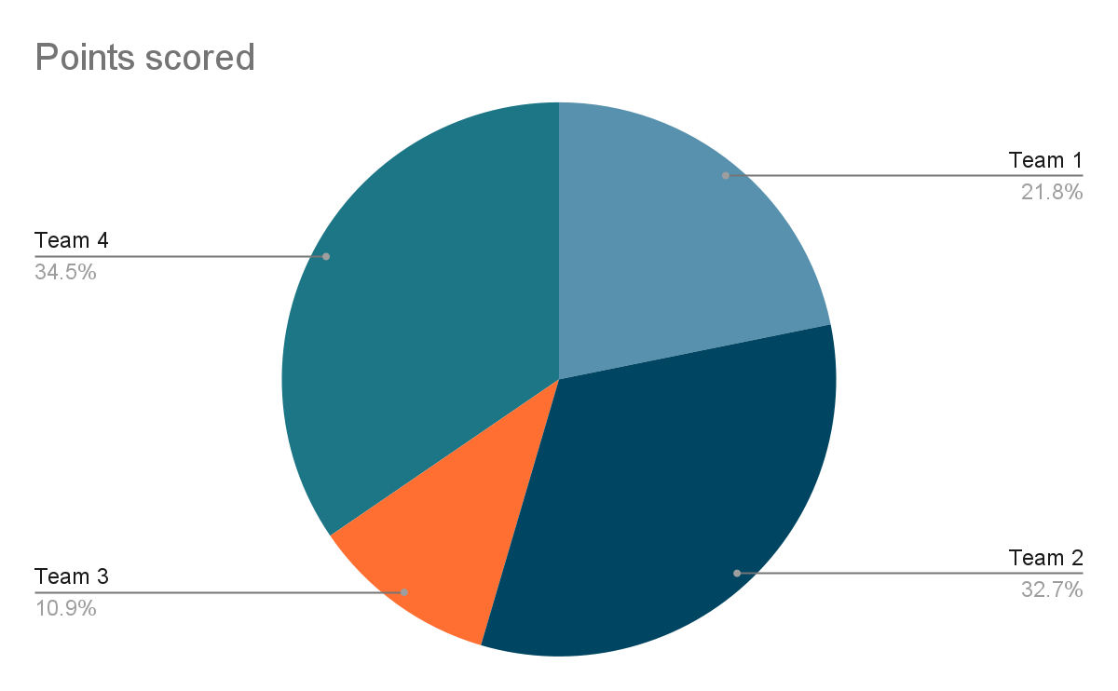
72% were prepared correctly with room for improvement in accuracy.
Findings

Slide 5
Focus on improving order accuracy: Address the 28% of orders that had issues and refine the ordering process on the tablets.
Suggest enhancing training and reviewing the interface for clarity.
Next Steps

Slide 6
Address the 12% of customers who experienced technical issues and the 18% who found the checkout process not quick, easy, or secure.
Recommend implementing more robust technical support and exploring alternatives for cash payments or faster digital checkouts.
Next Steps

